Slide 1


Standards & Regulations Presentation
9th November 2022

Slide 2


Standards Chosen
FAA Part 135 - Air Carrier and Operator Certification
ASTM F3005 - Specification for Batteries for Use in Small Unmanned Aircraft Systems (sUAS)
Notes:
4 and 5 are most important

Slide 3
FAA Part 135 - Air Carrier and Operator Certification
Notes:
1. Project description. This is a refined project description consisting of user needs and your resultant
proposed method of meeting them. It focuses on end results, not the details of the technology.
2. Use case. Give a brief use case coupled with a graphical representation of the system in its use
case/mission environment. N.B.: In the SDR, this item should be far less notional than in earlier
presentations. It should include photographs and/or videos of your real system in action. Show
the full system concept graphically, not just your robot. For your robot, show photos/videos of the
real system.

Slide 4

What is the Regulation About?
Part 135 outlines a certification process for pilots/operators that enables them to fly for compensation/ hire.
Part 135 certification is the only path for small drones to carry the property of another for compensation beyond visual line of sight
Some exemptions exist for rules that don’t apply to drone carriers
All part 135 applicants must go through 5 phases of the certification process
Notes:
The standard was not created specifically for drone operations but was a longstanding regulation that governs the inter and intrastate air transportation of goods or mail

Slide 5
Types of Part 135 Licenses
Four types of Part 135 Licenses
135 Single Pilot
135 Single Pilot in Command
135 Basic
Standard Part 135

Slide 6


Types - 135 Single Pilot
Notes:
Aircraft are limited to those type certificated with 9 passenger seats or less,
Operations are limited to the United States, Canada, Mexico, and the Caribbean,
No Category II or Category III instrument approach operations are allowed.

Slide 7

Types - 135 Single Pilot in Command
Restrictions:
Aircraft for 9 passengers or less
U.S., Canada, or Mexico only

Slide 8

Types - 135 Basic
Pilots
Planes
Manuals
Max 5 Pilots or Second in Command
Max 5 planes with only 3 different types allowed
Requirements:
Develop/maintain manuals and training programs
Required management position
Restrictions:
Aircraft for 9 passengers or less
U.S., Canada, or Mexico only

Slide 9
Types - 135 Standard
Pilots
Planes
Manuals
No Restrictions
No Restrictions
Must obtain authorization for every type of operation flown
Requirements:
Develop/maintain manuals and training programs
Management positions

Slide 10
Requirements for Certification
Company Ownership
Principal Base of Operation
Aircraft
Maintenance Requirements
Economic Authority
Insurance
Management Personnel (For Standard Certification)
Manuals
Training Programs
Drug & Alcohol Programs
TSA Requirements
Minimum Equipment List
Proving and Validation Testing
Adhere to the Pilots Records Improvement Act of 1996
Notes:
https://www.faa.gov/licenses_certificates/airline_certification/135_certification/general_req

Slide 11
Requirements for Certification
Company Ownership
Principal Base of Operation
Insurance
Management Personnel (For Standard Certification)
Proving and Validation Testing

Slide 12
Requirements for Certification
Company Ownership
Applicant
Citizen of the United States of America
Partnership
Each member must be a US Citizen
Corporation or Association
President and two-thirds of board of directors must be US citizens
At least 75% of voting interest must be controlled by US citizens
Notes:
https://www.faa.gov/licenses_certificates/airline_certification/135_certification/general_req

Slide 13
Requirements for Certification
Principal Base of Operation
Established physical location for principal base of operation
Documentation of ownership
Lease agreement
Letter of intent that it has established a physical location for its principal base of operation.
Insurance
Aircraft accident liability insurance
14 CFR Part 205
Filed using US Air Carriers Certificate of Insurance (OST Form 6410)
Notes:
https://www.faa.gov/licenses_certificates/airline_certification/135_certification/general_req

Slide 14
Requirements for Certification
Management Personnel
Director of Operations
3 years supervisory/managerial experience in the past 6 years
Chief Pilot
Pilot license
3 years experience as PIC in the past 6 years
Director of Maintenance
3 year experience as certified mechanic in the past 6 years
Includes experience maintaining same aircraft used by part 135 holder

Slide 15
Requirements for Certification
Proving and Validation Testing
25 hours of tests
5 hours of night flight
5 instrument approach procedures under simulated or actual conditions
Entry into a representative number of en route airports
Administrator may authorize deviations under special circumstances
Drone delivery

Slide 16
Who does the regulation apply to?
In short, any pilot or business seeking to fly for compensation or hire!
For drones, it is the regulatory path for any drone that is:
carrying the property of another for compensation
beyond visual line of sight
The drone laws:
Not fully developed but in progress
Only 4 companies with Part 135 licenses today
Wing
UPS Flight Forward
Amazon
Zipline
7-8 others are in the approval process!
Notes:
The standard was not created specifically for drone operations but was a longstanding regulation that governs the inter and intrastate air transportation of goods or mail

Slide 17
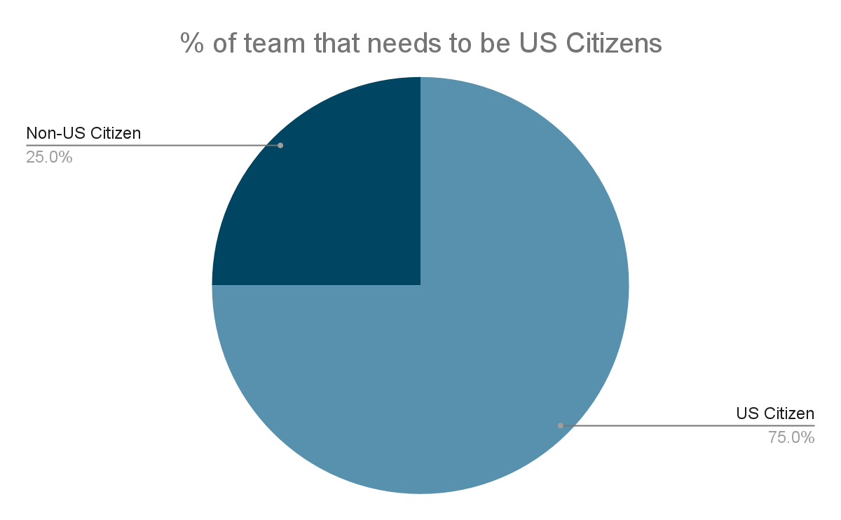
How does this apply to Project DAIR?
% of our team that is a US Citizen?
0% !

Slide 18
How does this apply to Project DAIR?
We can’t make a company here, as we are not US Citizens
Even with citizenship, we would need to:
Establish a base of operations
Have a lot more experience flying than we do today (another 2 years at least!)
Bring in more individuals with the right experience
Fortunately, this does not affect our project in the context of MRSD.
Why? We’re not getting any compensation!

Slide 19
ASTM F3005 - Specification for Batteries for Use in Small Unmanned Aircraft Systems (sUAS)
Notes:
1. Project description. This is a refined project description consisting of user needs and your resultant
proposed method of meeting them. It focuses on end results, not the details of the technology.
2. Use case. Give a brief use case coupled with a graphical representation of the system in its use
case/mission environment. N.B.: In the SDR, this item should be far less notional than in earlier
presentations. It should include photographs and/or videos of your real system in action. Show
the full system concept graphically, not just your robot. For your robot, show photos/videos of the
real system.

Slide 20
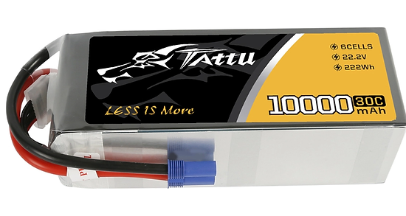
What is the Standard About?
This standard defines the requirements for batteries used in small Unmanned Aircraft Systems (sUAS).
sUAS includes the aircraft and all required on and off-board subsystems, including payload and control stations.
Batteries used in these subsystems shall comply with this standard unless failure of the battery will not compromise safety of the sUAS.
Notes:
The standard was not created specifically for drone operations but was a longstanding regulation that governs the inter and intrastate air transportation of goods or mail.
Since any one of the preceding subsystems may affect reliability and thus safety of the sUAS, batteries used in those subsystems shall comply with this standard unless failure of the battery will not compromise safety.

Slide 21
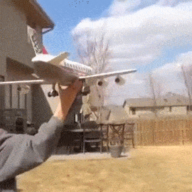
What is the Standard About?
Criticality of standard:
Loss of independent power for safe flight termination
Failure of primary power for the FCS resulting in loss of control
Failure of ignition power or primary power for electric propulsion
Notes:
The standard was not created specifically for drone operations but was a longstanding regulation that governs the inter and intrastate air transportation of goods or mail.
Since any one of the preceding subsystems may affect reliability and thus safety of the sUAS, batteries used in those subsystems shall comply with this standard unless failure of the battery will not compromise safety.

Slide 22


Who does the standard apply to?
Batteries targeted for use in sUAS weighing less than 25kg
Manufacturers and suppliers of batteries
Users of batteries in sUAS platforms

Slide 23
Section 5: Cells
Section 5 pertains to cell suppliers & pack assemblers.
Cell Suppliers
Process Control and QA plans
Technical and Safety Data Sheets
Labelled Cells for traceability
Lot Number, and
Supplier Name
Pack Assemblers
Lot and Received-Voltage Testing
Pack Assembly Requirements:
All cells are from the same lot, or
Cells are compatible enough
Final Testing:
2 charge-discharge cycles
Test for rated capacity

Slide 24
Sections 6&7: Mechanical & Electrical Design
Sections 6 and 7 pertain to pack assemblers
Mechanical Assembly
Sturdy wiring and cell connections
Vibration and puncture resistance
Outer pack design with:
Supplier/Serial Number
Battery Capacity
Safety Warnings
Recovery Identification - to be easily detectable in a crash site
Electrical Design
IC Engines/Electric Propulsion:
NiCd, NiMH, Lilon, Life, LiPo, or SLA
No Vented Lead Acid cells
Capacity tested and optimally charged
Wiring/Connectors specifications met
Node Access
Thermal Performance tested

Slide 25
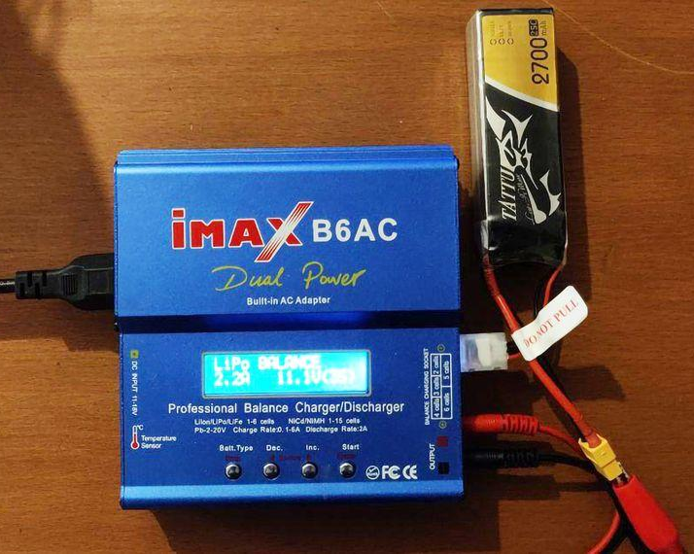
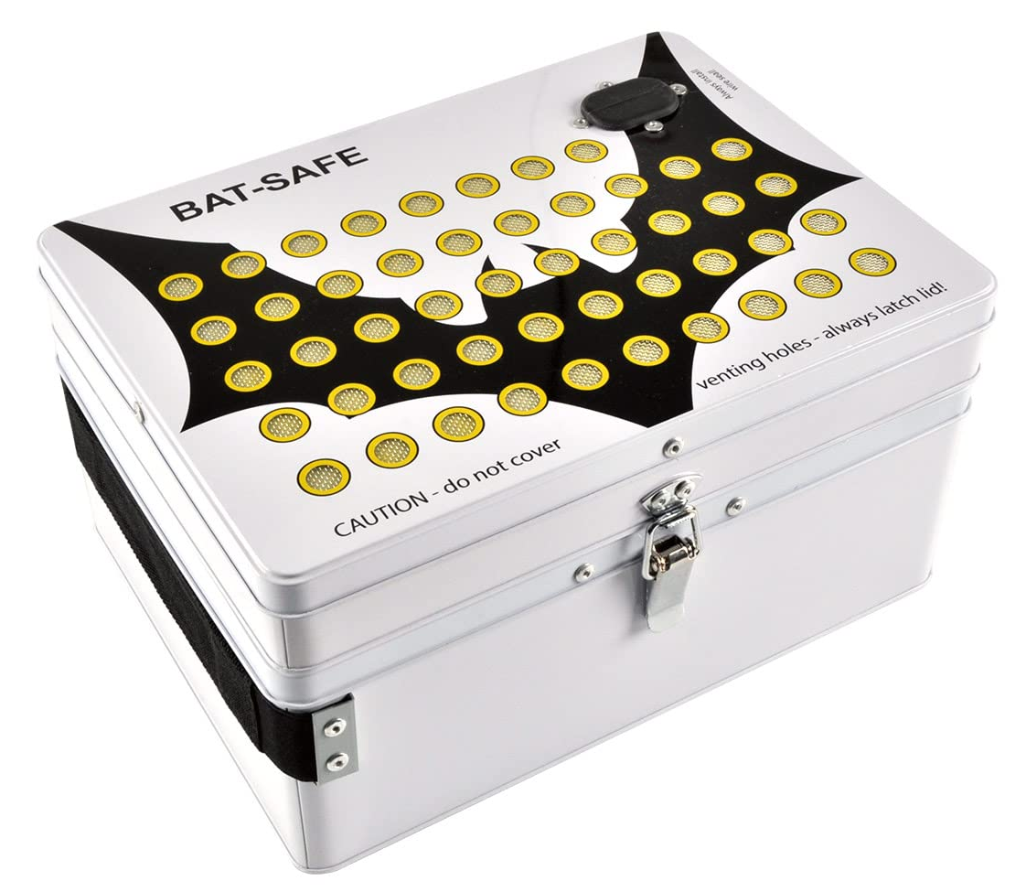
Section 8: Maintenance
Charging
Series Cell Balancing for Lithium Chemistries
Charging may be done in a flame and explosion resistant enclosure
Physical Inspection after charging
How it applies to Us
Balance charge our batteries to ensure all cells are charged to the same level
Never charge above the C rating level mentioned by the manufacturer
Charging batteries in Bat-Safe boxes
Balance charging
Bat-Safe/Bat-Box
Notes:
Section 8 discusses maintenance as it pertains to users, i.e., Team DAIR!

Slide 26
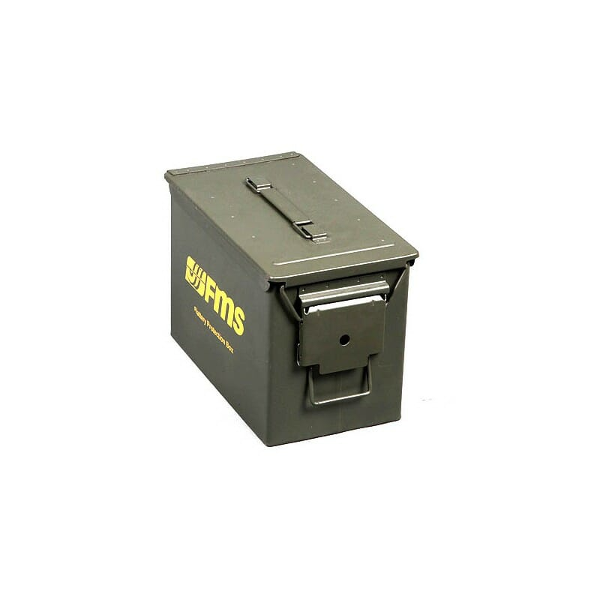
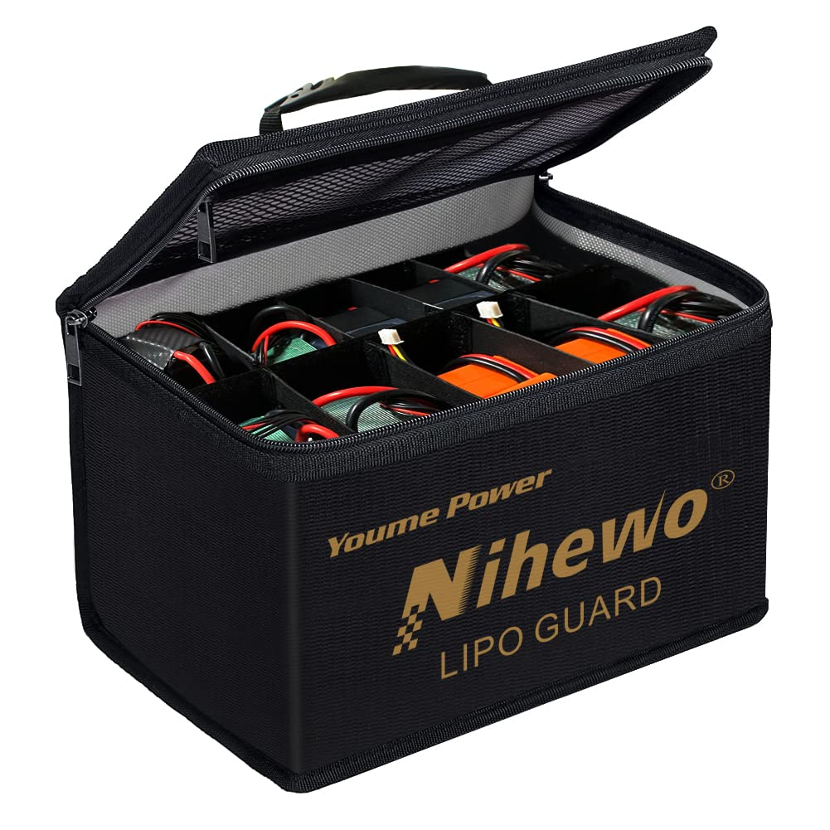
Section 8: Maintenance
Storage
Pack shall be charged/discharged to level that is optimal for storage based on the particular chemistry
Any time a pack is out of service for more than one month
How it applies to Us
Batteries charged/discharged to storage voltage as recommended by the manufacturer
Batteries stored in fire and explosion proof bags
Ammo box
Lipo storage box
Notes:
Section 8 discusses maintenance as it pertains to users, i.e., Team DAIR!
Charging, we

Slide 27
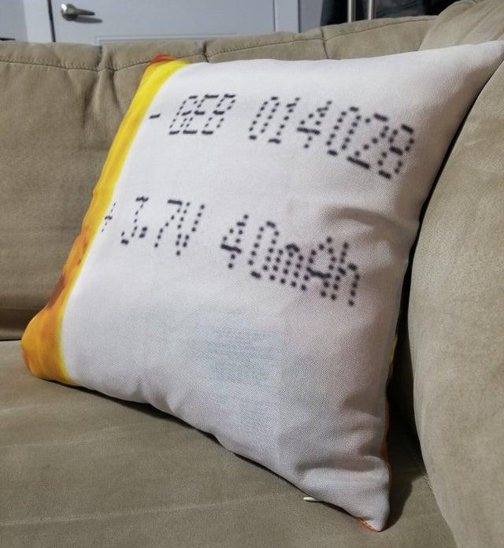

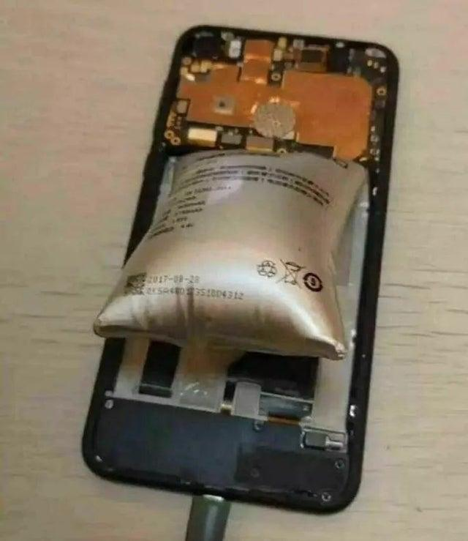
Section 8: Maintenance
Damage evaluation
Pack involved in crash or any event involving physical damage must be evaluated
Disposal
Electrolyte leakage
Odor
Punchered or Physical damage
Severe Swelling
How it applies to Us
None of the above has happened yet
LiPo pillow cases
Using lithium polymer batteries
as a raptor engine
Notes:
Section 9 discusses maintenance as it pertains to users, i.e., Team DAIR!

Slide 28
Thank you for your time!
Questions?
Notes:
Link Dump:
https://pilotinstitute.com/part-135-drone-delivery/
https://www.faa.gov/licenses_certificates/airline_certification/135_certification/cert_process
https://www.faa.gov/hazmat/air_carriers/operations/drones
https://www.faa.gov/licenses_certificates/airline_certification/135_certification/general_info

